Slide 1
Requirement Engineering and Modeling
Session 05
Course : COMP6100/Software Engineering
Effective Period : Desember 2017

Slide 2
These slides have been adapted from
Pressman, R.S. (2015). Software Engineering : A Practioner's Approach. 8th ed. McGraw-Hill Companies.Inc, Americas, New York. ISBN : 978 1 259 253157. Chapter 8,9,10 and 11
Acknowledgement

Slide 3
LO 2 : Explain the software engineering practices and business environment
Learning Objectives

Slide 4
Contents
Requirement Engineering
Requirement Modeling : Scenario-Based Methods
Requirement Modeling : Class-Based Methods
Requirement Modeling : Behavior, Patterns, and Web/Mobile Apps

Slide 5
Requirement Engineering
Inception—ask a set of questions that establish …
  basic understanding of the problem
  the people who want a solution
  the nature of the solution that is desired, and
  the effectiveness of preliminary communication and collaboration between the customer and the developer
Elicitation—elicit requirements from all stakeholders
Elaboration—create an analysis model that identifies data, function and behavioral requirements
Negotiation—agree on a deliverable system that is realistic for developers and customers

Slide 6
Requirement Engineering
Specification—can be any one (or more) of the following:
  A written document
  A set of models
  A formal mathematical
  A collection of user scenarios (use-cases)
  A prototype
Validation—a review mechanism that looks for
  errors in content or interpretation
  areas where clarification may be required
  missing information
  inconsistencies (a major problem when large products or systems are engineered)
  conflicting or unrealistic (unachievable) requirements.
Requirements management

Slide 7
Building the Analysis Model
Elements of the analysis model
Scenario-based elements
  Functional—processing narratives for software functions
  Use-case—descriptions of the interaction between an “actor” and the system
Class-based elements
  Implied by scenarios
Behavioral elements
  State diagram
Flow-oriented elements
  Data flow diagram

Slide 8
Requirement Modeling : Scenario-Based Methods
Requirements analysis
  specifies software’s operational characteristics
  indicates software's interface with other system elements
  establishes constraints that software must meet
Requirements analysis allows the software engineer (called an analyst or modeler in this role) to:
  elaborate on basic requirements established during earlier requirement engineering tasks
  build models that depict user scenarios, functional activities, problem classes and their relationships, system and class behavior, and the flow of data as it is transformed.

Slide 9
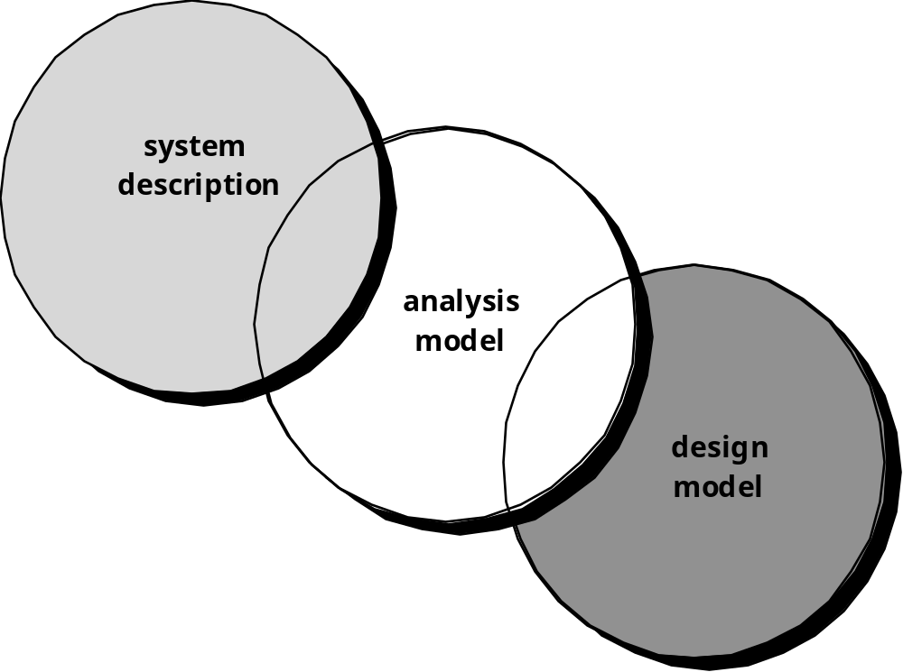
Requirement Modeling : Scenario-Based Methods
A Bridge

Slide 10
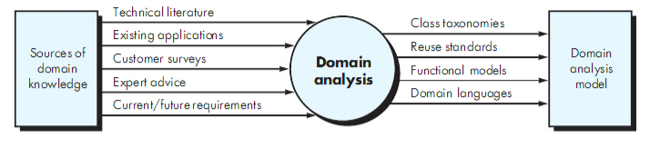
Requirement Modeling : Scenario-Based Methods
Domain analysis

Slide 11
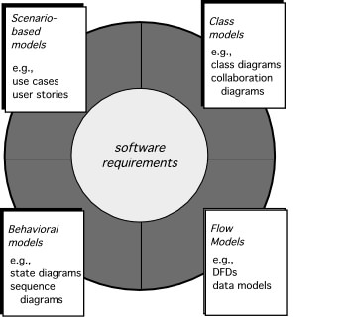
Requirement Modeling : Scenario-Based Methods
Elements of Requirements Analysis

Slide 12
Requirement Modeling : Scenario-Based Methods
Although the success of a computer-based system or product is measured in many ways, user satisfaction resides at the top of the list.
If you understand how end users (and other actors) want to interact with a system, your software team will better able to properly characterize requirements and build meaningful analysis and design models
Hence, requirement modeling with UML begins with the creation of scenarios in the form of use cases, activity diagrams, and swimlane diagrams

Slide 13
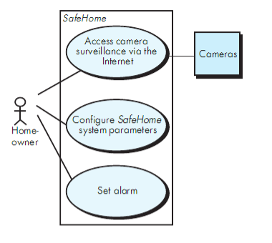
Requirement Modeling : Scenario-Based Methods
The steps of scenario-based modeling :
Creating a preliminary use case
Refining a preliminary use case
Writing a formal use case
Preliminary use case diagram for the SafeHome system

Slide 14
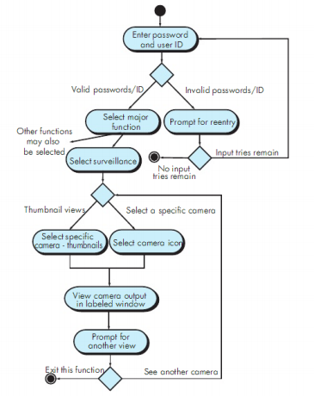
Requirement Modeling : Scenario-Based Methods
UML Model That Supplement the Use Case
Developing an activity diagram

Slide 15
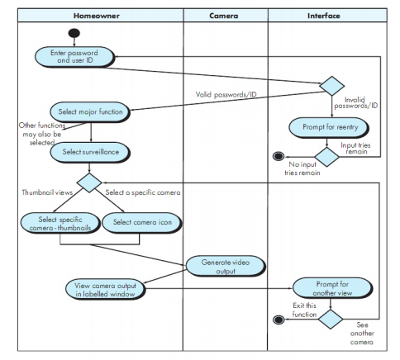
Requirement Modeling : Scenario-Based Methods
UML Model That Supplement the Use Case
Swimlane Diagram

Slide 16
Requirement Modeling : Class-Based Methods
Class-Based Modeling represents the objects that the system will manipulate the operations (also called methods or services) that will be applied to the objects to effect the manipulation, relationships (some hierarchical) between the objects, and the collaborations that occur between the classes that are defined
The elements of a class-based model include classes and objects, attributes, operations, class-responsibility-collaborator (CRC) models, collaboration diagrams, and packages.

Slide 17
Requirement Modeling : Class-Based Methods
Identifying Analysis Classes
External entities (e.g., other systems, devices, people) that produce or consume information to be used by computer-based system
Things (e.g., reports, displays, letters, signals) that are part of the information domain for the problem
Occurances or events (e.g., a property transfer or the completion of series of robot movements) that occur within the context of system operation.
Roles (e.g., manager, engineer, salesperson) played by people who interact with the system
Organizational units (e.g., division, group, team) that are relevantto an application
Places (e.g., manufacturing floor or loading dock) that establish the context of the problem and the overall function of the system
Structures (e.g., sensors, four-wheeled vehicles, or computers) that define a class of objects or related classes of objects

Slide 18
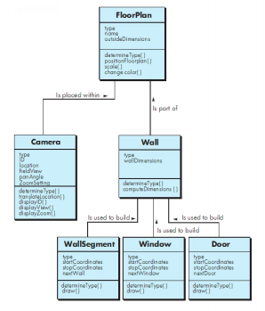
Requirement Modeling : Class-Based Methods
Class diagram FloorPlan

Slide 19
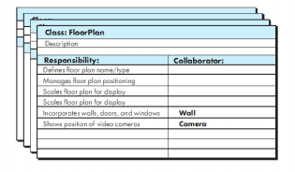
Requirement Modeling : Class-Based Methods
A CRC Model Index Card

Slide 20
Requirement Modeling : Behavior, Patterns, and Web/Mobile Apps
Creating a Behvior Model
The behavioral model indicates how software will respond to external events or stimuli.
To create the model, you should perform the following steps :
Evaluate all use cases to fully understand the sequence of interaction within the system
Identify events that drive the interaction sequence and understand how these events relate to specific objects.
Create a sequence for each use case.
Build a state diagram for the system, and
Review the behavioral model to verify accuracy and consistency

Slide 21
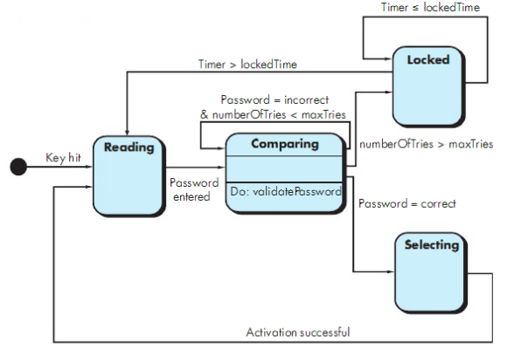
Requirement Modeling : Behavior, Patterns, and Web/Mobile Apps
State diagram for the ControlPanel class

Slide 22
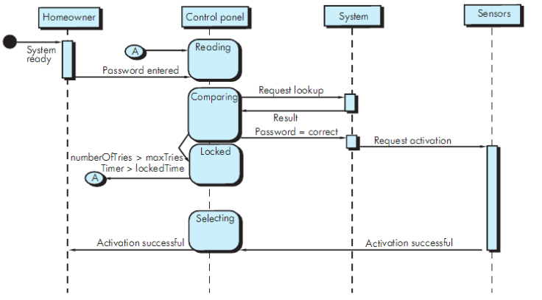
Requirement Modeling : Behavior, Patterns, and Web/Mobile Apps
Sequence diagram (partial) for the SafeHome security function

Slide 23
Patterns for Requirement Modeling
  Pattern name: A descriptor that captures the essence of the pattern.
  Intent: Describes what the pattern accomplishes or represents
  Motivation: A scenario that illustrates how the pattern can be used to address the problem.
  Forces and context: A description of external issues (forces) that can affect how the pattern is used and also the external issues that will be resolved when the pattern is applied.
  Solution: A description of how the pattern is applied to solve the problem with an emphasis on structural and behavioral issues.
  Consequences: Addresses what happens when the pattern is applied and what trade-offs exist during its application.
  Design: Discusses how the analysis pattern can be achieved through the use of known design patterns.
  Known uses: Examples of uses within actual systems.
  Related patterns: On e or more analysis patterns that are related to the named pattern because (1) it is commonly used with the named pattern; (2) it is structurally similar to the named pattern; (3) it is a variation of the named pattern.

Slide 24
When Do We Perform Analysis?
Requirement Modeling
for Web and Mobile Apps
In some WebE situations, analysis and design merge. However, an explicit analysis activity occurs when …
  the WebApp to be built is large and/or complex
  the number of stakeholders is large
  the number of Web engineers and other contributors is large
  the goals and objectives (determined during formulation) for the WebApp will effect the business’ bottom line
  the success of the WebApp will have a strong bearing on the success of the business

Slide 25
The Content Model
Requirement Modeling
for Web and Mobile Apps
Content objects are extracted from use-cases
  examine the scenario description for direct and indirect references to content
Attributes of each content object are identified
The relationships among content objects and/or the hierarchy of content maintained by a WebApp
  Relationships—entity-relationship diagram or UML
  Hierarchy—data tree or UML

Slide 26
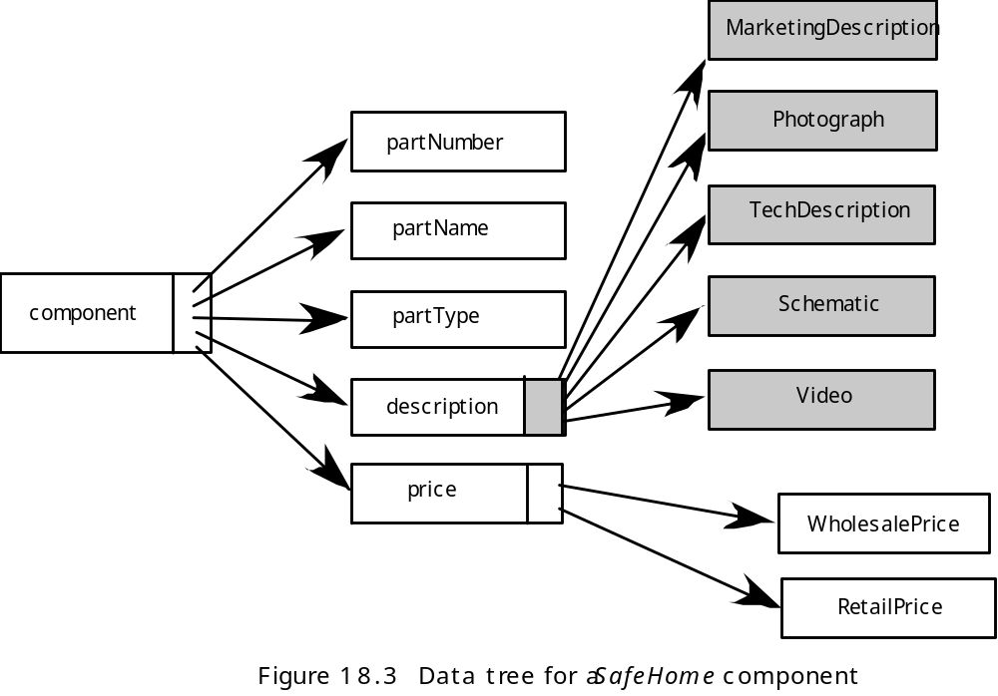
Data Tree
Requirement Modeling
for Web and Mobile Apps

Slide 27
The Interaction Model
Requirement Modeling
for Web and Mobile Apps
Composed of four elements:
  use-cases
  sequence diagrams
  state diagrams
  a user interface prototype

Slide 28
The Functional Model
Requirement Modeling
for Web and Mobile Apps
The functional model addresses two processing elements of the WebApp
  user observable functionality that is delivered by the WebApp to end-users
  the operations contained within analysis classes that implement behaviors associated with the class.
An activity diagram can be used to represent processing flow

Slide 29
The Configuration Model
Requirement Modeling
for Web and Mobile Apps
Server-side
  Server hardware and operating system environment must be specified
  Interoperability considerations on the server-side must be considered
  Appropriate interfaces, communication protocols and related collaborative information must be specified
Client-side
  Browser configuration issues must be identified
  Testing requirements should be defined

Slide 30
References
Pressman, R.S. (2015). Software Engineering : A Practioner's Approach. 8th ed. McGraw-Hill Companies.Inc, Americas, New York. ISBN : 978 1 259 253157.
Requirements Engineering / Specification, http://www.youtube.com/watch?v=wEr6mwquPLY
UML 2.0 Tutorial, http://www.youtube.com/watch?v=OkC7HKtiZC0
Introduction to Model-View-View-Model (MVVM) Pattern, http://www.youtube.com/watch?v=pY60lLotZCg

Slide 31
Q & A

